Slide 1
Learning shortest path tours to all pubs in UK
Sabeer Bakir
Student ID: 16333886
Supervisor: Dr. Deepak Ajwani

Slide 2
Introduction
Combinatorial optimization is an area of research that consists of finding an optimal ordering/subset from a finite set of objects.
NP-Hard
Researchers have worked for decades to find good solutions for these problems.
Can we learn the solutions to these optimization problems?

Slide 3
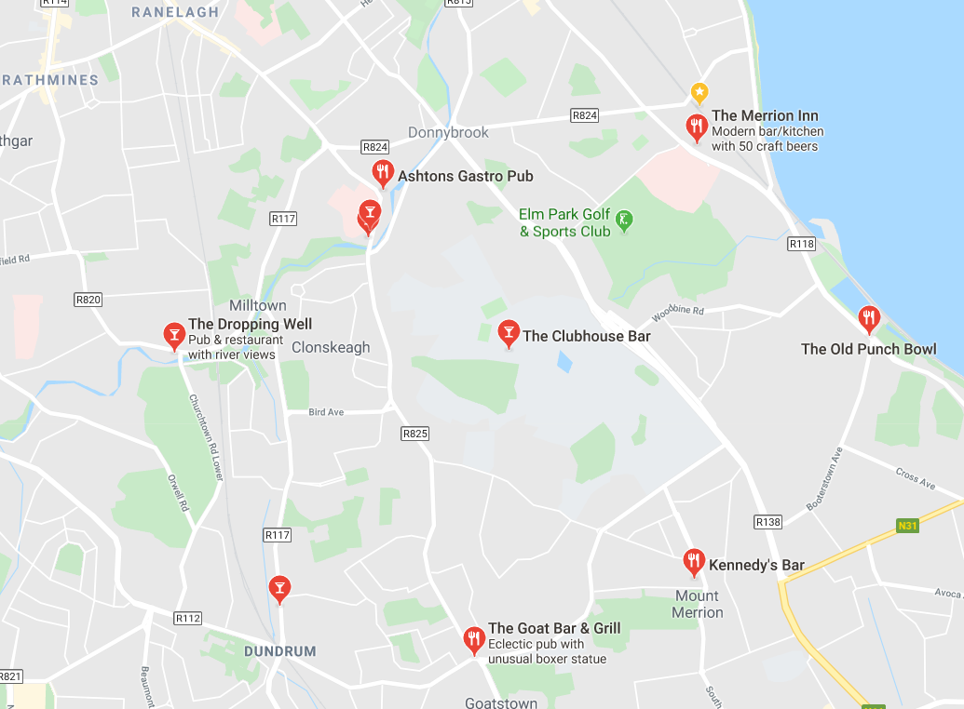
Travelling Salesman Problem

Slide 4
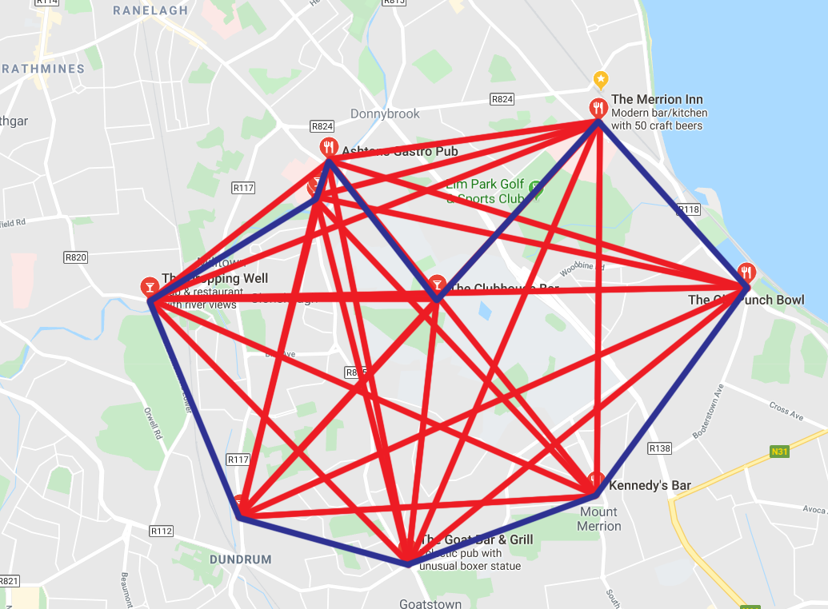
Travelling Salesman Problem

Slide 5
Related Work
There are many methods used to tackle the travelling salesman problem:
Exact Algorithms
Approximation algorithms
Heuristics
Meta-Heuristics
Learning Approaches:
Supervised/Unsupervised Machine learning
Reinforcement Learning

Slide 6
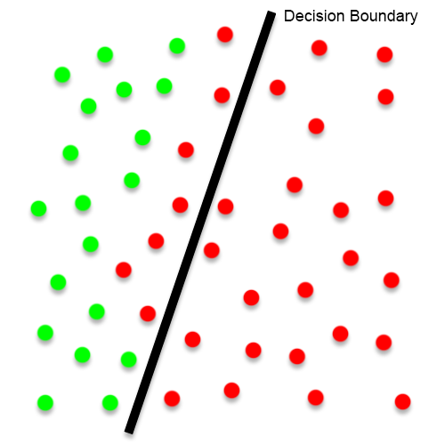
Outline of Approach
Build a binary classification model to learn if an edge is a part of the travelling salesman tour.
This method allows the edge-list to be pruned.
Use approximation algorithm on a smaller dataset.

Slide 7
Outline of Approach (contd.)
Features to describe an edge:
Ranking (wrt. both incident nodes)
Weight
Etc.
Early training will use Euclidian distance as the weight.
Ground Truth will be gathered using the Concorde TSP Solver.

Slide 8
Data Collection
Data scraped from https://www.pubsgalore.co.uk/.
Up-to-date list of pubs within the UK.
Contains attributes such as:
Name
Location coordinates
Address
70,000+ pubs on this website.

Slide 9
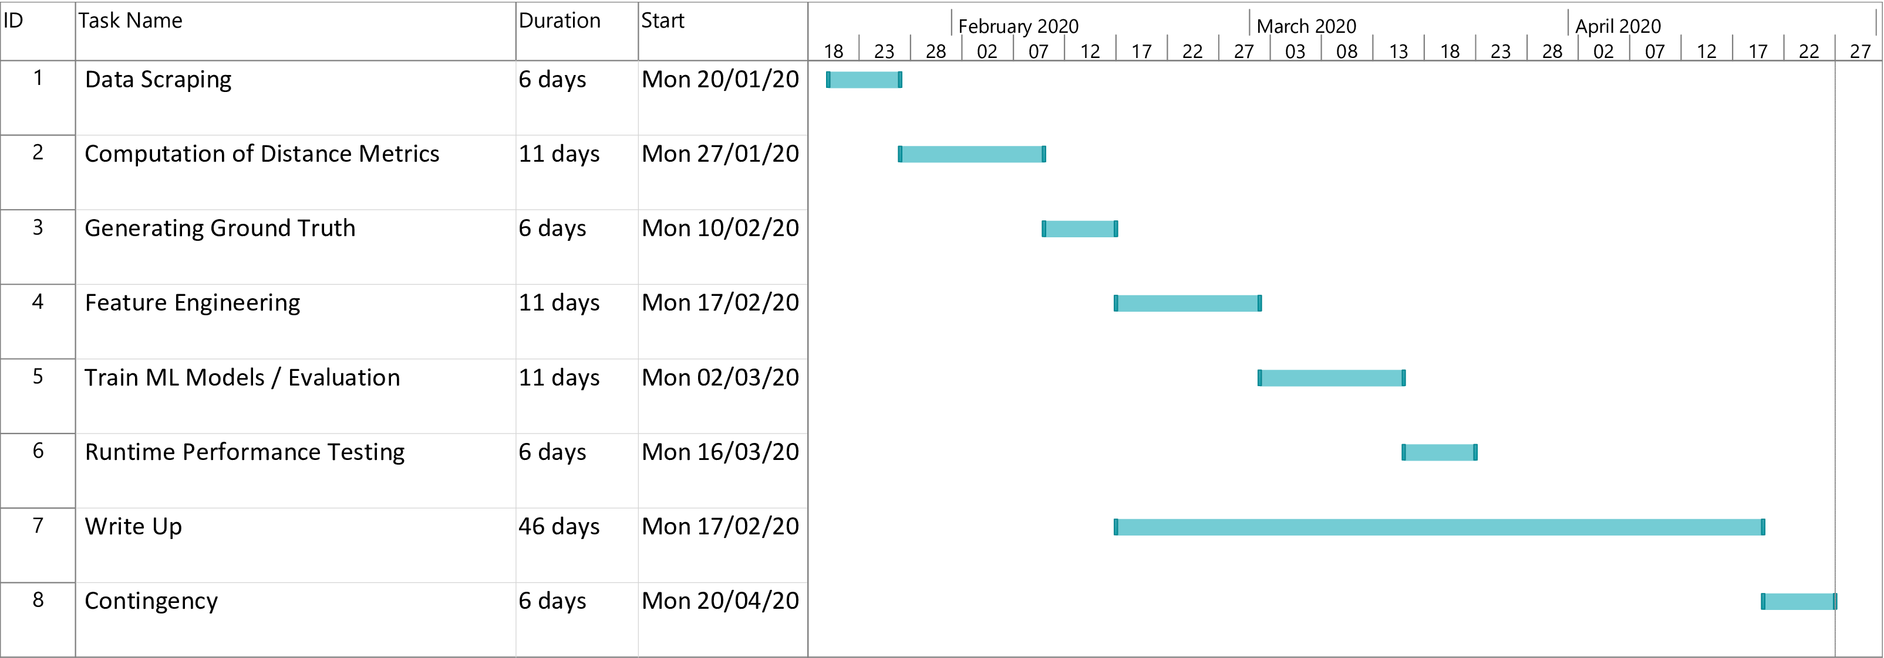
Timeline

